Slide 1

Useless Thermometer
Group 22
Members: Hieu, Jessika, Veikka

Slide 2
1, Project summary
A box that can turn itself off whenever the switch is turned on.
Include an ultrasonic sensor to make the box open the lid for warning whenever it detects a hand.
Include a temperature sensor that can transfer the data to the LCD screen.
The screen will show the temperature and humidity from the sensor when the lid is opened, otherwise it will not show.

Slide 3
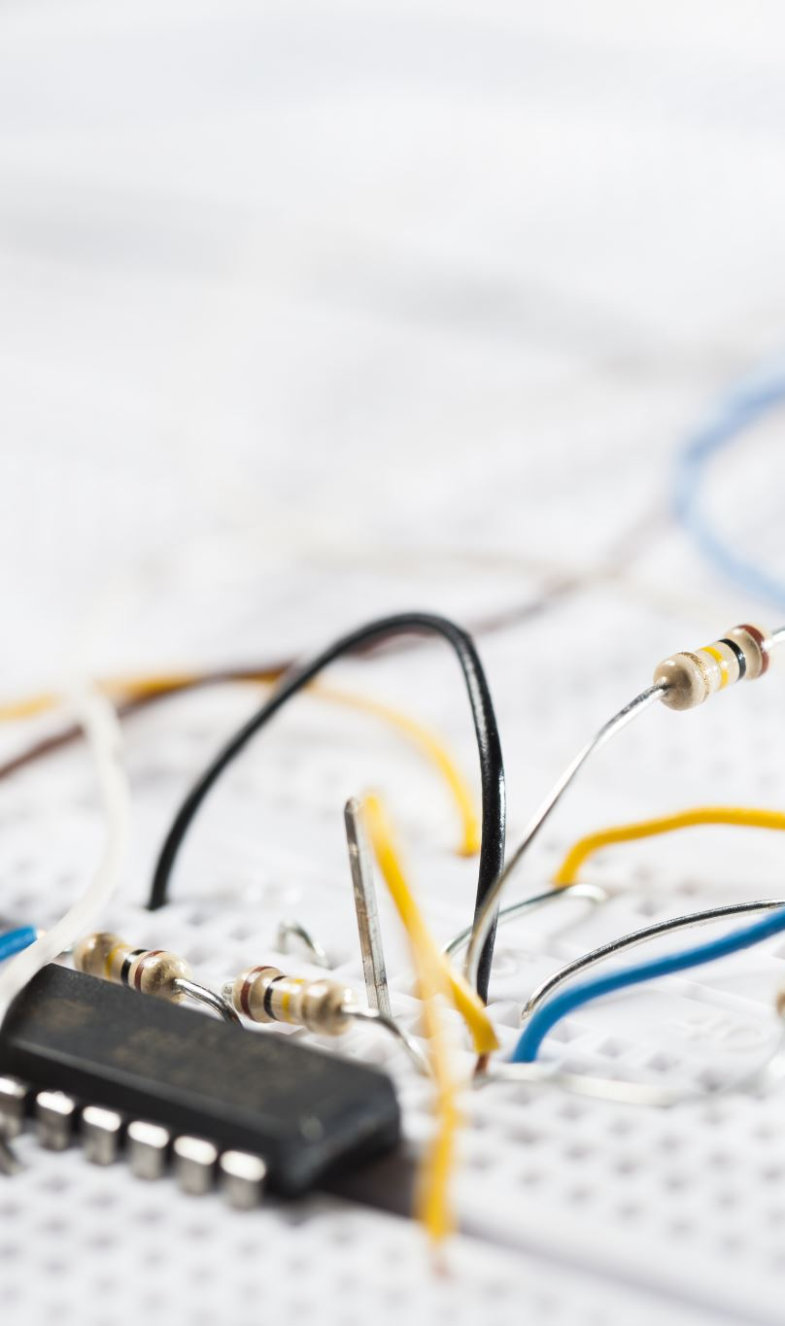
2, Bill of material
2 servos (1 for finger and 1 for door)
1 LCD screen
1 ultrasonic sensor
1 DHT temperature and humidity sensor
2 SPDT switches
Screws and cables
Battery clip
Breadboard and Arduino Uno

Slide 4

3, What We have done
The project is finished and work as intended
Video demo: https://drive.google.com/file/d/1QdGf8axTZ0pi8DQzUQkBKtjkETqiMUvu/view?usp=share_link
New repository: https://github.com/BuiDaiHieu/DiFab---Group-22

Slide 5
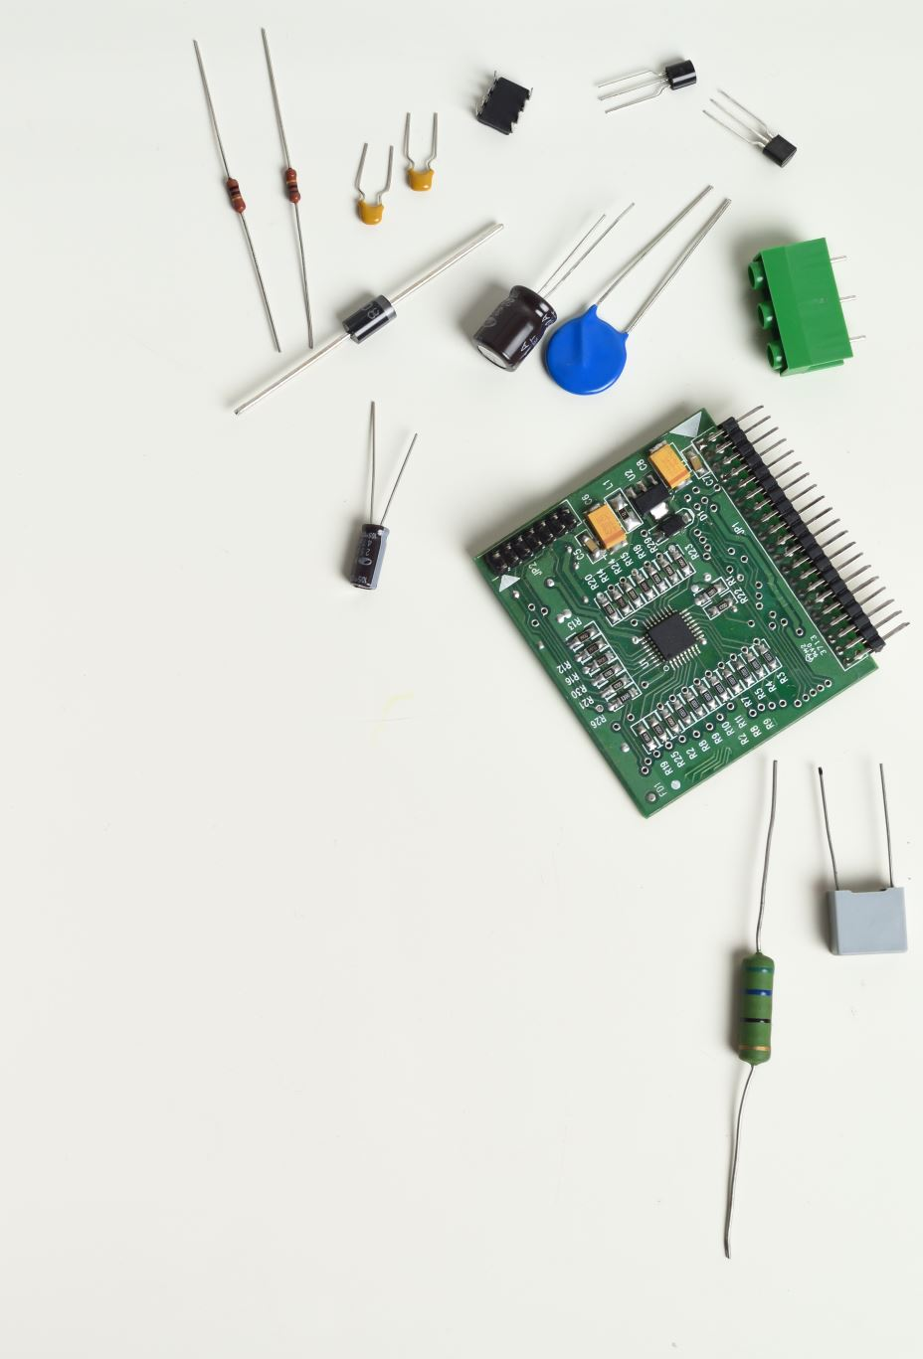
4, what we learned
To work as a team to make an interactive device
To record the work every week
2D laser cutting and designing using Inkscape
3D printing process and basics of Fusion360
Ultilize sensors in making an electronic circuit
CPP code for Arduino

Slide 6

Thank you

